Slide 1
HTML FRAMES

Slide 2
Frame
A frame is a container that divides a web browser into different sections.
Each section (frame) can be used to display a different web page.
Many web pages can be displayed at the same time using frames.
These sections work independently but appears simultaneously in the browser.

Slide 3
Frame
<FRAMESET> Tag
<FRAMESET> tag is used to define the style and number of sections (frames) in which the web browser has to be divided.
It makes division on the basis of number of rows or columns.

Slide 4
Frame Attributes
ROWS : Divides the web browser into multiple sections based on the number of rows. Its value can be given as:
Number of pixels.
Percentage of the web browser area.
Wildcard (*) to indicate all of the remaining space.
COLS : Divides the web browser into multiple sections based on the number of columns. Its value can be given as:
Number of pixels.
Percentage of the web browser area.
Wildcard (*) to indicate all of the remaining space.

Slide 5
Example
<FRAMESET ROWS =“40%,40%,20%”>
</FRAMESET>
It divides the web browser area into three horizontal parts. The first two parts consists of 40% each and the last part consists of 20% of the web browser area.
<FRAMESET COLS =“40%,30%,*”>
</FRAMESET>
It divides the web browser area into three vertical parts. The first part consists of 40% and the second part consists of 30% and the remaining of the web browser is allocated to the third part by using (*).

Slide 6
<FRAME> Tag
<FRAME> tag is used to specify the web page that will be displayed in that particular frame.
<FRAME> tag is used within <FRAMESET> tag.
Attributes of <FRAME> tag are:
SRC : Specifies the page to be displayed in the frame.
NAME : Specifies the name of the frame.
NORESIZE : Makes the frame un-resizable.
SCROLLING : Specifies the appearance of horizontal and vertical scrollbars of a frame.
The possible values of SCROLLING are YES, NO and AUTO.

Slide 7
<FRAME> Tag Example:
<FRAMESET COLS =“33%, 33%, *”>
<FRAME SRC =“Left.HTML” NAME =“Left”>
<FRAME SRC =“Center.HTML” NAME =“Center”>
<FRAME SRC =“Right.HTML” NAME =“Right”>
</FRAMESET>

Slide 8
TARGET Frame
The target attribute in <A> tag is used to specify the target frame in which the page will be loaded.
It can be used to open different web pages in a frame while other frames remains static.
The possible values of TARGET attribute are:
parent/_top : The page is loaded into the frameset containing the current page or it will replace the frameset loaded in the current whole browser window.
blank : The page is loaded into the new browser window.
self : The page is loaded into the same frame in which the link exists. It is the default target.
Frame Name : A page can be loaded into a specific frame by specifying the frame’s name.

Slide 9
Nested Frames
A frame within a frame is called nested frame.
Nested frame are used to divide the web browser area into multiple levels.
Example:
<FRAMESET ROWS ="20%,80%">
<FRAME SRC ="Top2.HTML" NAME ="Top“ SCROLLING="No" NORESIZE>
<FRAMESET COLS ="20%,80%">
<FRAME SRC ="Menu.HTML" NAME ="Menu“ SCROLLING="No" NORESIZE>
<FRAME SRC ="Main.HTML" NAME ="Main">
</FRAMESET>
</FRAMESET>

Slide 10
Disadvantages of Frames
There are few drawbacks with using frames, so it's never recommended to use frames in your webpages −
Some smaller devices cannot cope with frames often because their screen is not big enough to be divided up.
Sometimes your page will be displayed differently on different computers due to different screen resolution.
The browser's back button might not work as the user hopes.
There are still few browsers that do not support frame technology.

Slide 11
Important
The <frameset> tag was used in HTML 4 to define a frameset.
It is Not Supported in HTML5.
Use the <iframe> tag to embed another document within the current HTML document:
<iframe src=“abc.html“ width=“100%” height=“200”></iframe>

Slide 12
<iframe> Attributes
The <iframe> tag specifies an inline frame.
An inline frame is used to embed another document within the current HTML document.
The <iframe> tag supports the Global Attributes in HTML.
The <iframe> tag also supports the Event Attributes in HTML.

Slide 13
<iframe> Attributes
<Iframe> has the following attributes:
Name
Src
Height (in pixels)
width

Slide 14
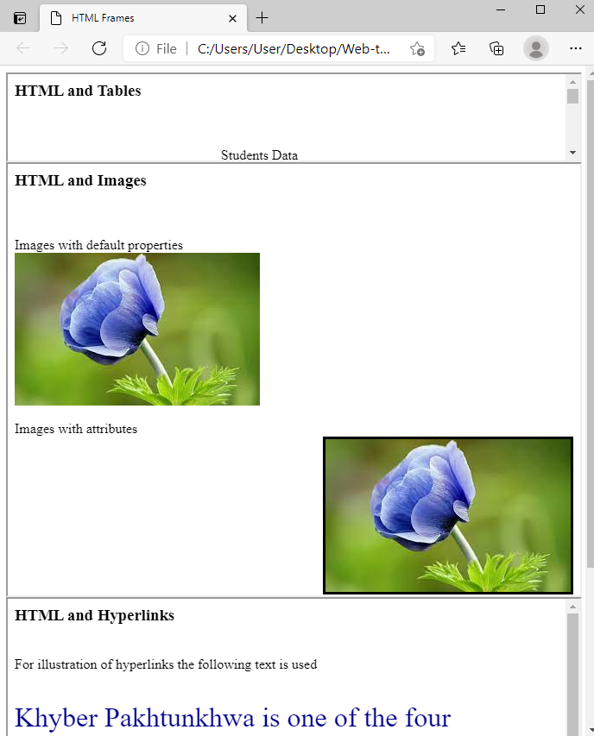
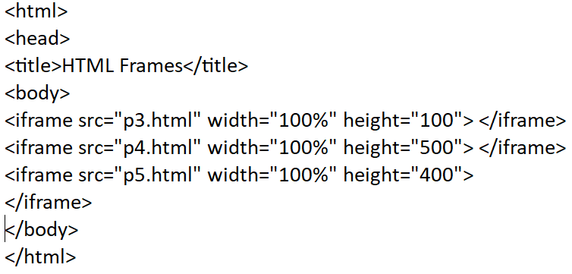
Example

Slide 15
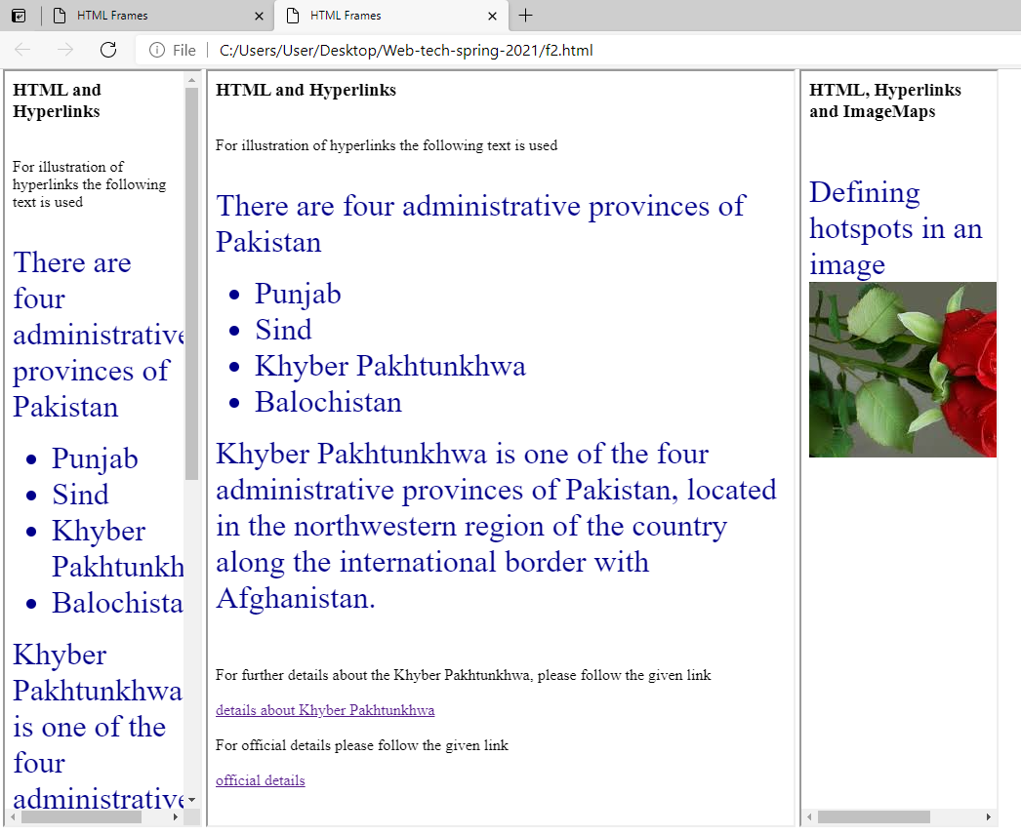
Example
<iframe src="p6.html" width="200" height="100%"> </iframe>
<iframe src="p7.html" width="600" height="100%"> </iframe>
<iframe src="p8.html" width="200" height="100%">
</iframe>

Slide 16
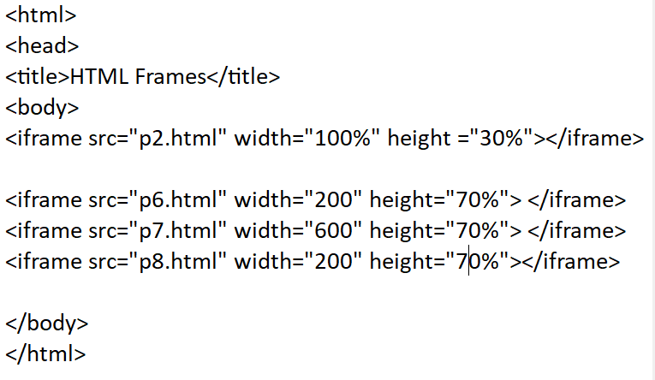
Nested iframe

Slide 17
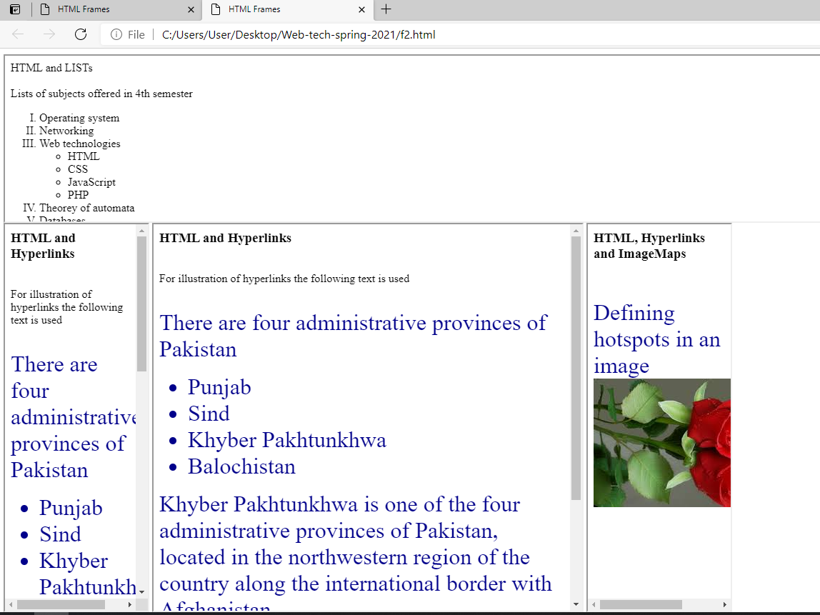
Nested iframe

Slide 18
Some more HTML tags
Comments
Metadata

Slide 19
Comments
Comment is a piece of code which is ignored by any web browser. It is a good practice to add comments into your HTML code, especially in complex documents, to indicate sections of a document, and any other notes to anyone looking at the code. Comments help you and others understand your code and increases code readability.
HTML comments are placed in between <!-- ... --> tags. So, any content placed with-in <!-- ... --> tags will be treated as comment and will be completely ignored by the browser.

Slide 20
<meta> tag
The <meta> tag is used to provide such additional information and important keywords about the document. This tag is an empty element and so does not have a closing tag but it carries information within its attributes.
You can include one or more meta tags in your document based on what information you want to keep in your document but in general, meta tags do not impact physical appearance of the document so from appearance point of view, it does not matter if you include them or not.
these keywords are used by the search engines while indexing your webpage for searching purpose.

Slide 21
<meta> tag
The metadata is added to your web pages by placing <meta> tags inside the header of the document which is represented by <head> and </head> tags.
A meta tag can have following attributes in addition to core attributes
Name: Name for the property. Can be anything. Examples include, keywords, description, author, revised, generator etc.
Content: Specifies the property's value.
Scheme: Specifies a scheme to interpret the property's value (as declared in the content attribute).

Slide 22
<meta> tag
<head>
<title>Meta Tags Example</title>
<meta name = "keywords" content = "HTML, Meta Tags, Metadata" />
<meta name = “description" content = “All about HTML Tags" />
<meta name = “author" content = “Nosheen" />
</head>

